Slide 1
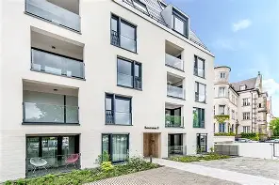
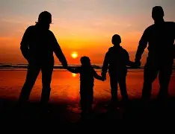
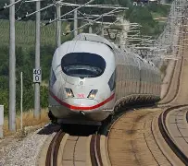
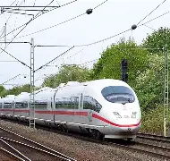
My life and My Dream Job

Slide 2
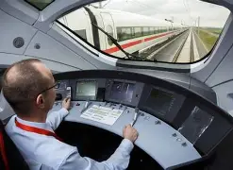
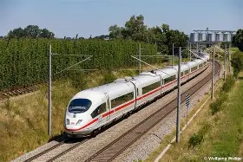
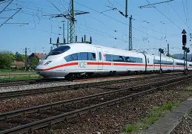
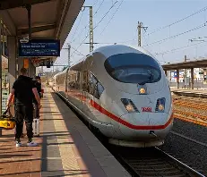
My Dream Job:
My Dream job is train driver. I drive people from A to B and I can see beautiful landscapes. My favourite train is the DB BR 403 Ice 3.

Slide 3
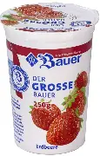
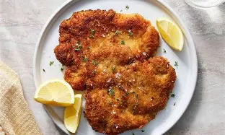
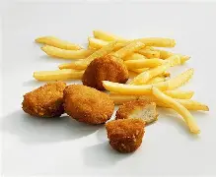
My favourite Food:
My favourite Food is Schnitzel or Chicken nuggets with fries.
My favourite Dessert is Strawberry
Yogurt.

Slide 4
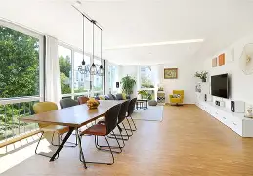
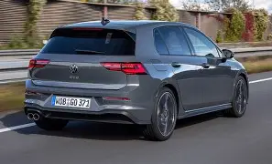
When I am 22:
When I am 22, I want to have an apartment and I want to live in Berlin. I want to have a car.

Slide 5
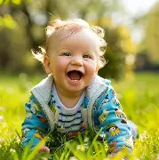
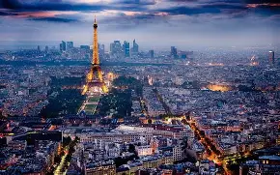
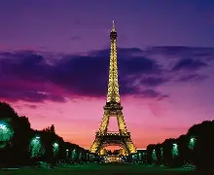
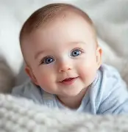
When I am 25:
I will have a girlfriend and my first Baby.
I want to go with my family to Paris.

Slide 6
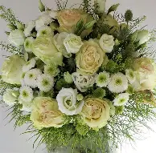
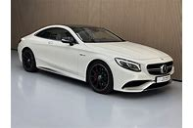
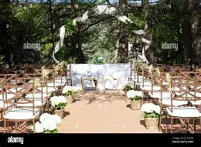
When I am 27:
When I am 27, I want to get married.
I will live in a house and I would like a Mercedes Benz S63 AMG.

Slide 7



Thanks for listening, goodbye
THANKS

